Slide 1

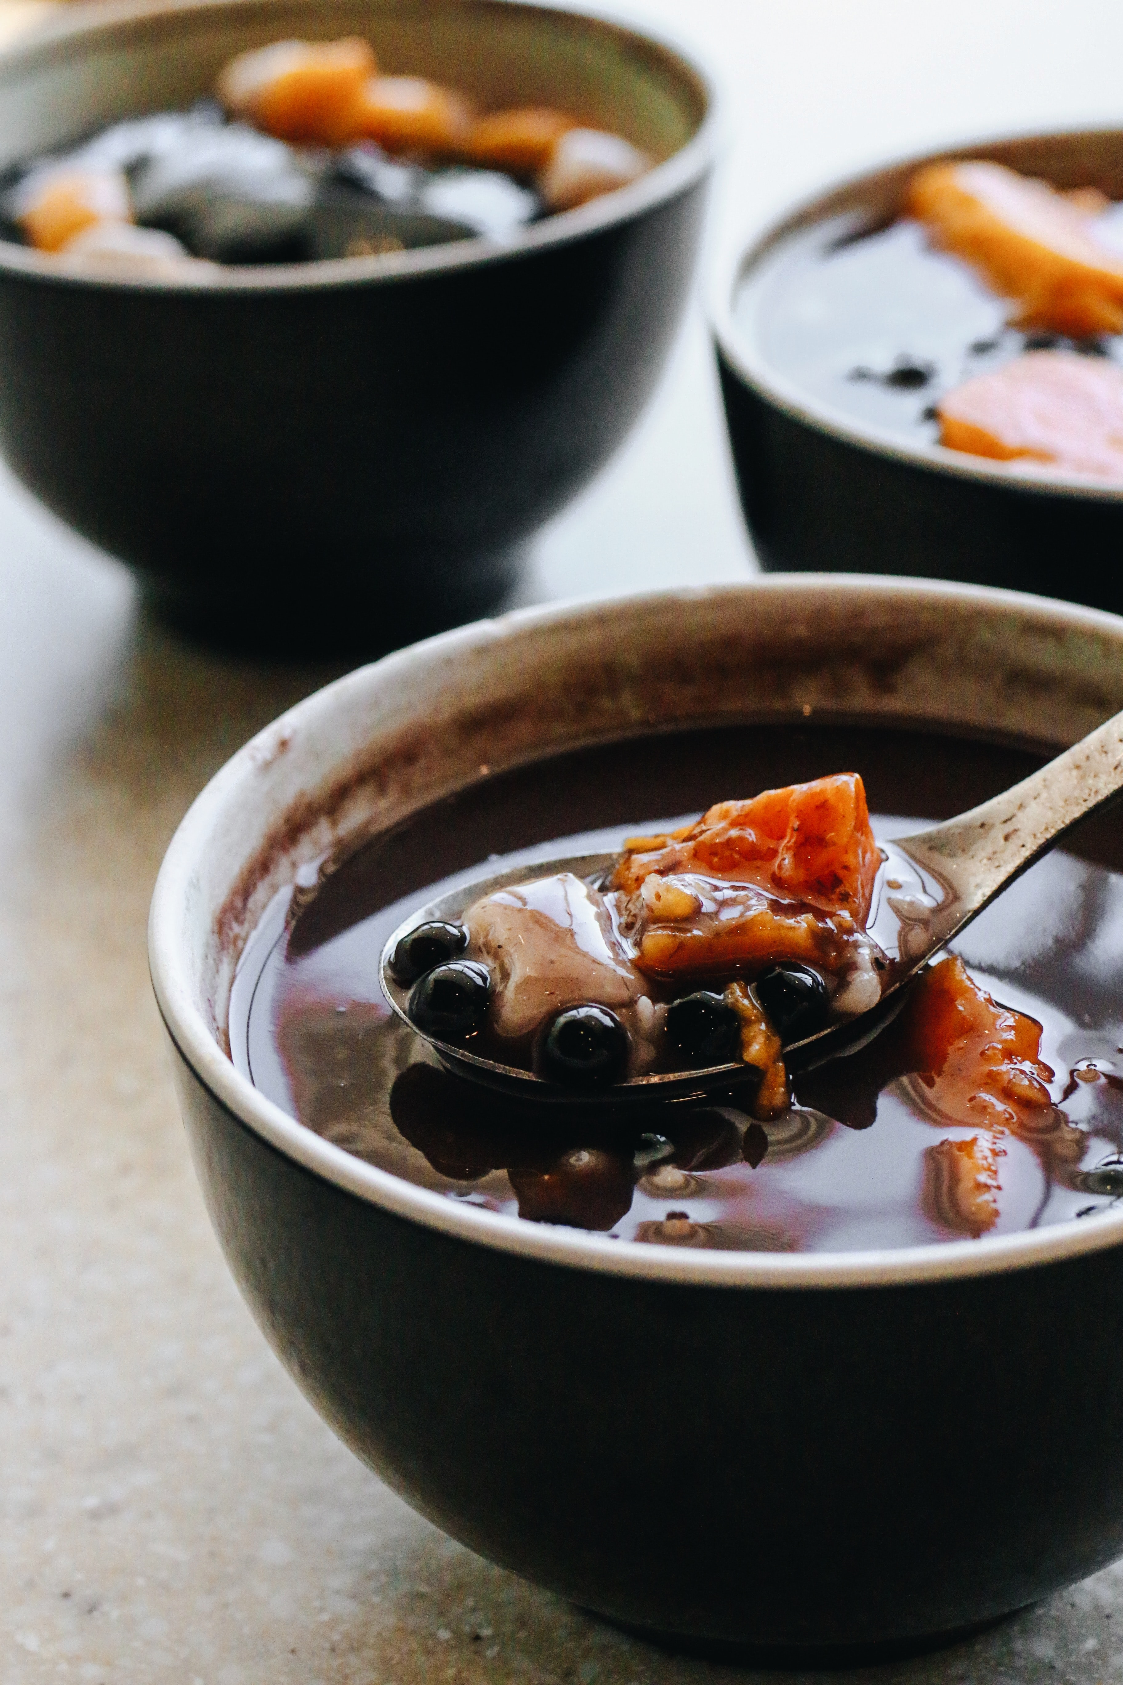


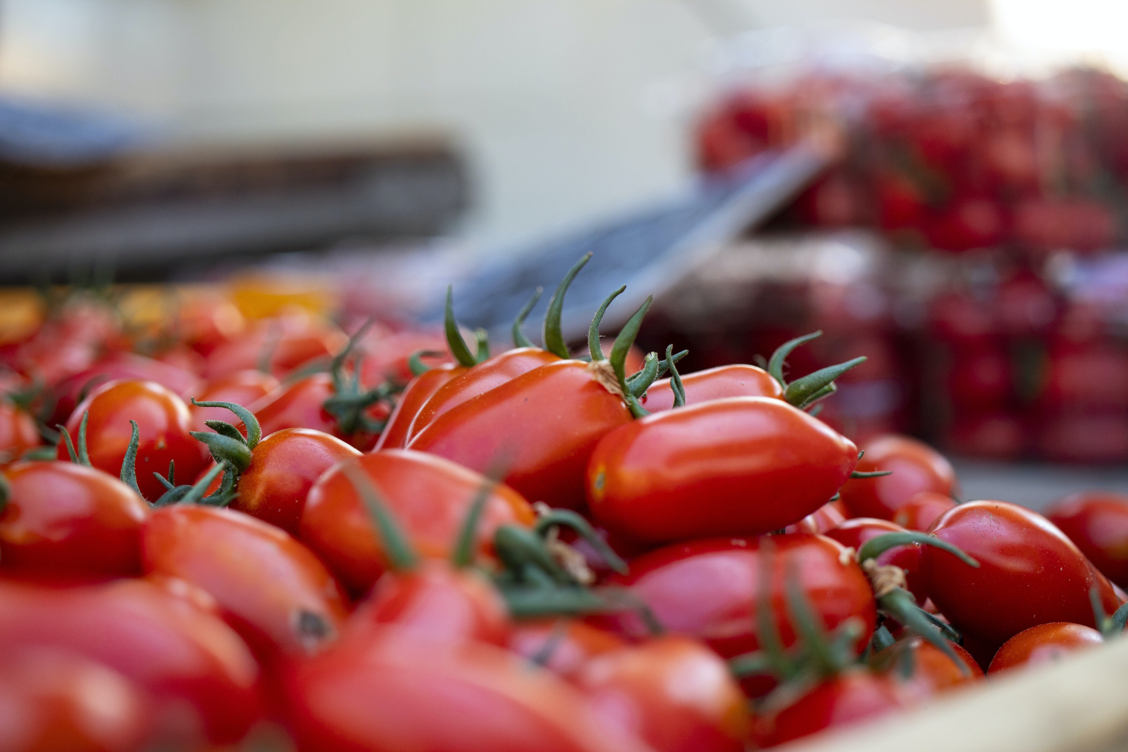
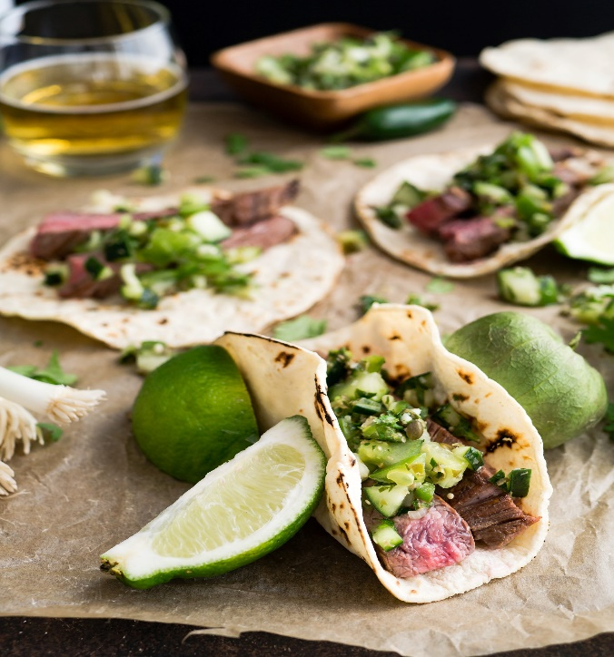
Protein Projection
An IPPS and HDH Collaboration

Slide 2

Our Mission
1. Finding the most efficient and cost-effective avenues of sourcing protein to the UCSD Campus.
2. Specifically, we will be looking at third quarter projections of various proteins for 2020.

Slide 3

July 2020 Outlook
What we can learn based on current market status, as of July 2020.

Slide 4
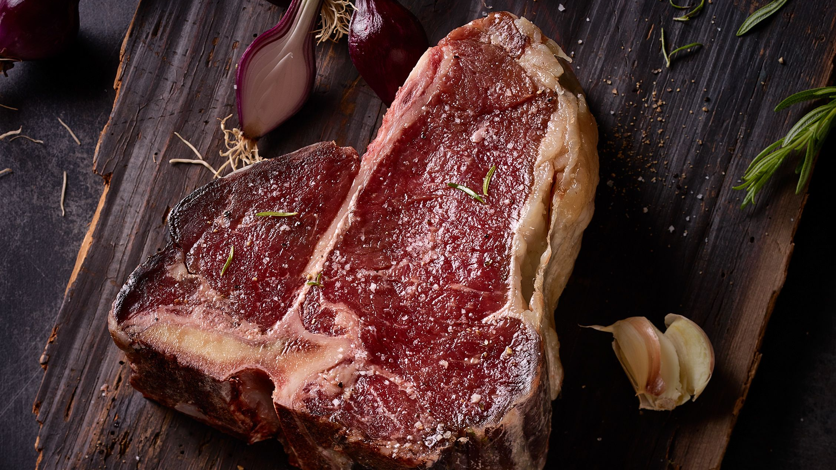
Beef/Cattle

Slide 5
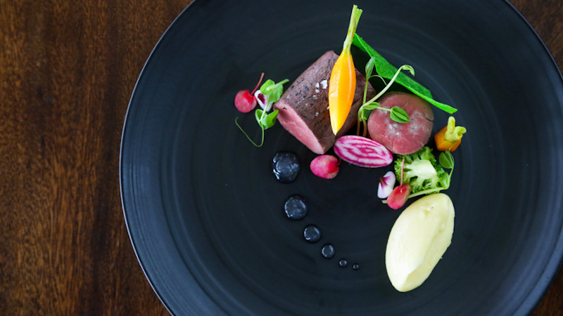
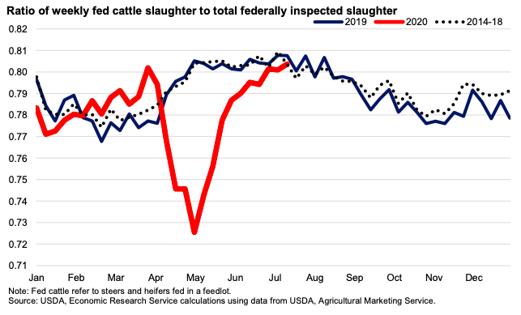
- In April/May, the rate of cattle slaughter dropped drastically - As a result, many cattle that would have been slaughtered, gained excess weight

Slide 6

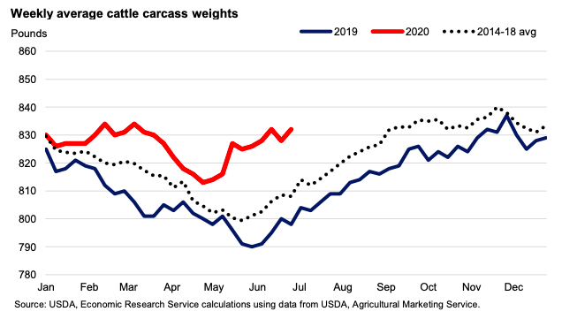
- Notice the increase in carcass weights for June and July compared to other years - With slaughter rates back to average and increased carcass weights, USDA is projecting a larger production of beef/cattle

Slide 7
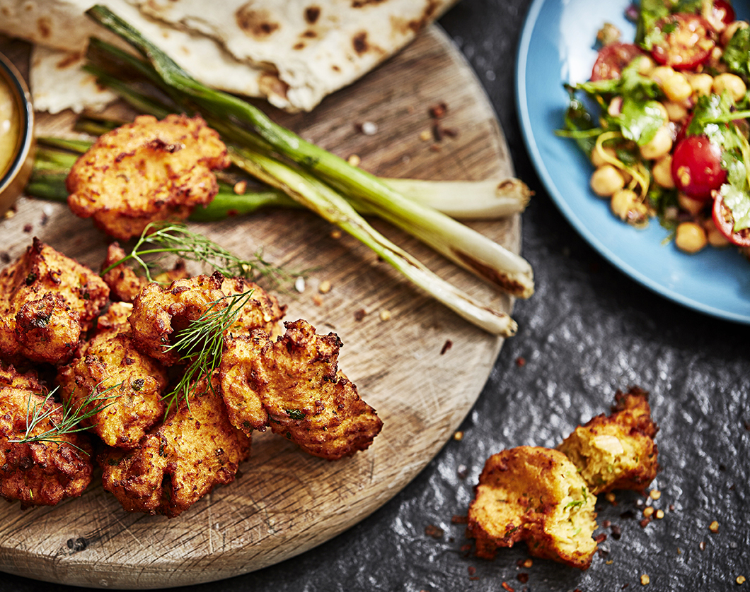
Lower prices for beef/cattle in the coming months until the carcass weights get back to average

Slide 8
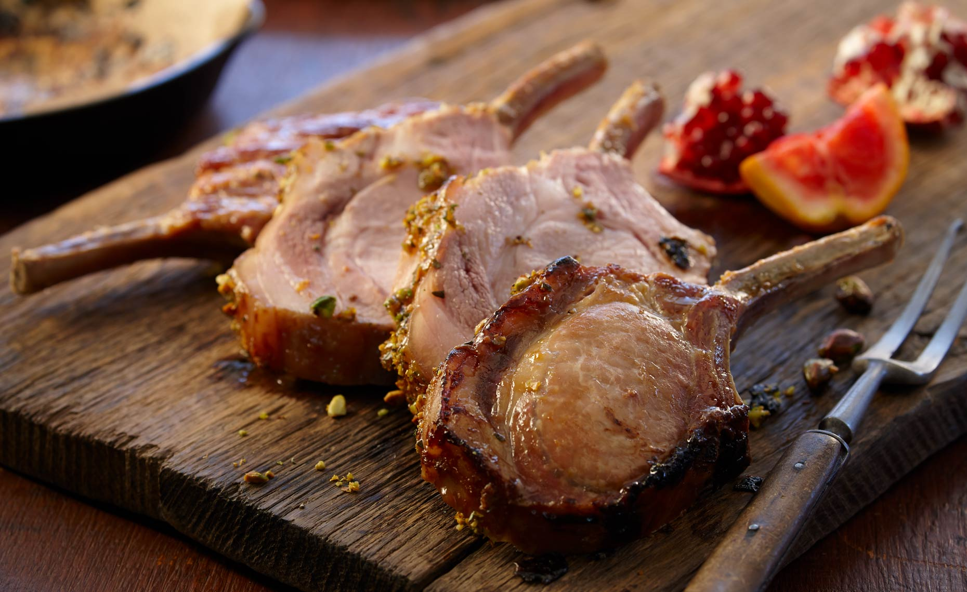
Pork

Slide 9
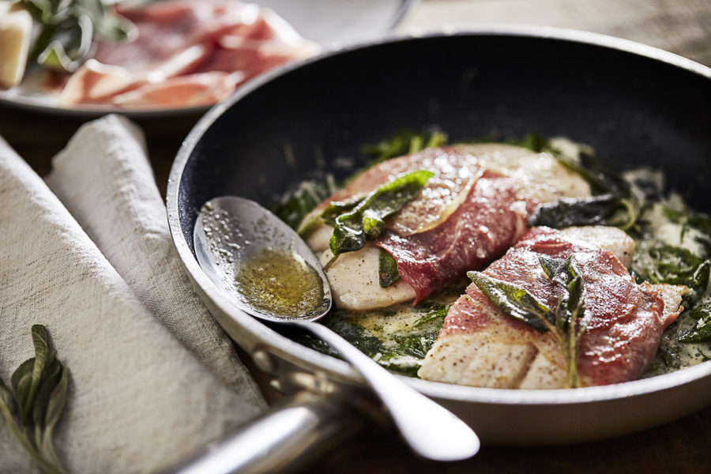
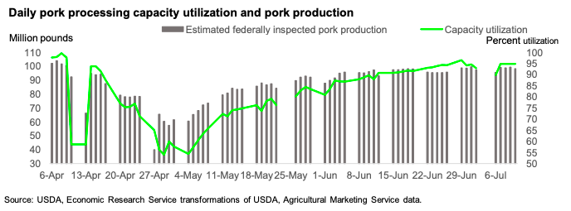
- Similar market fluctuations to beef regarding decreased slaughter capacities in April and May
* Focus on the GREEN line which represents Capacity Utilization

Slide 10
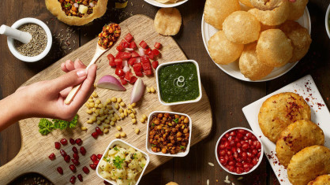
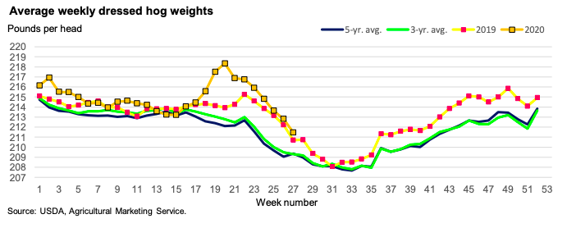
- Farmers placed hogs on “maintenance rations” - Both slaughter rates and weights have normalized
- Still, there is a 9% increase in production compared to last year
* Week number 20 (the peak) is the week of May 20

Slide 11
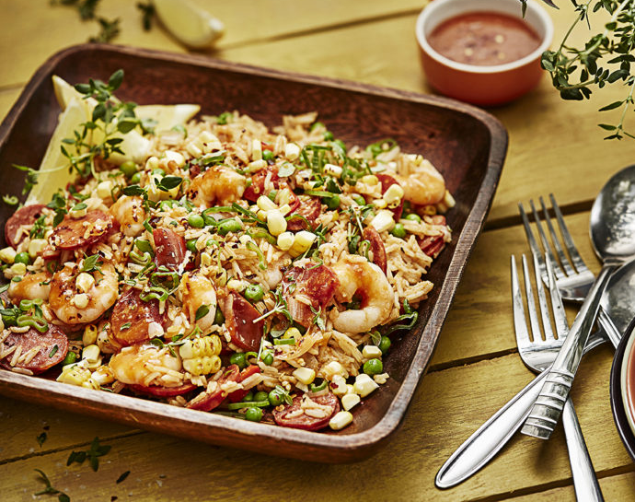
Average third quarter prices for hogs is expected to be 24% lower than last year

Slide 12
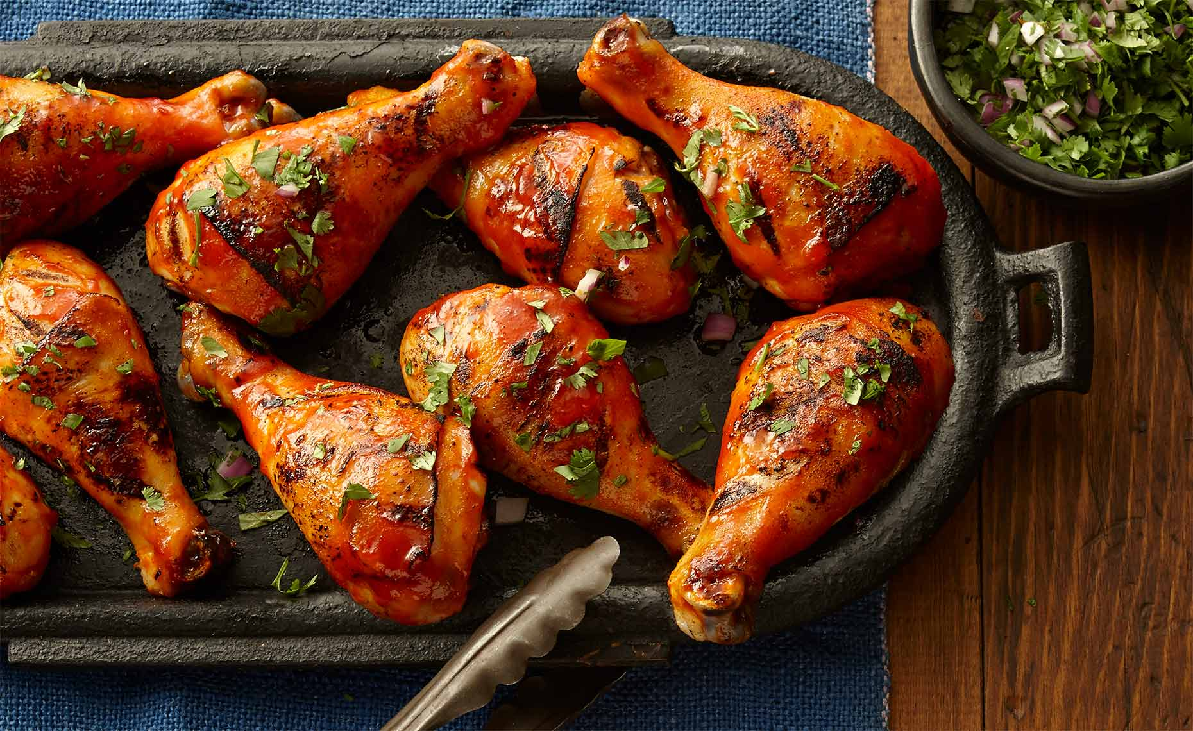
Chicken

Slide 13

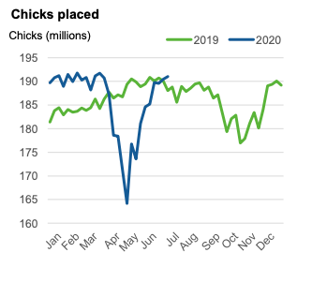
- Broiler production is running at a YOY increase of 2.2% - Slaughter rates and average live-bird weights have both increased from last year - Increase in Chicks Placed points to improved producer expectations for the coming months

Slide 14
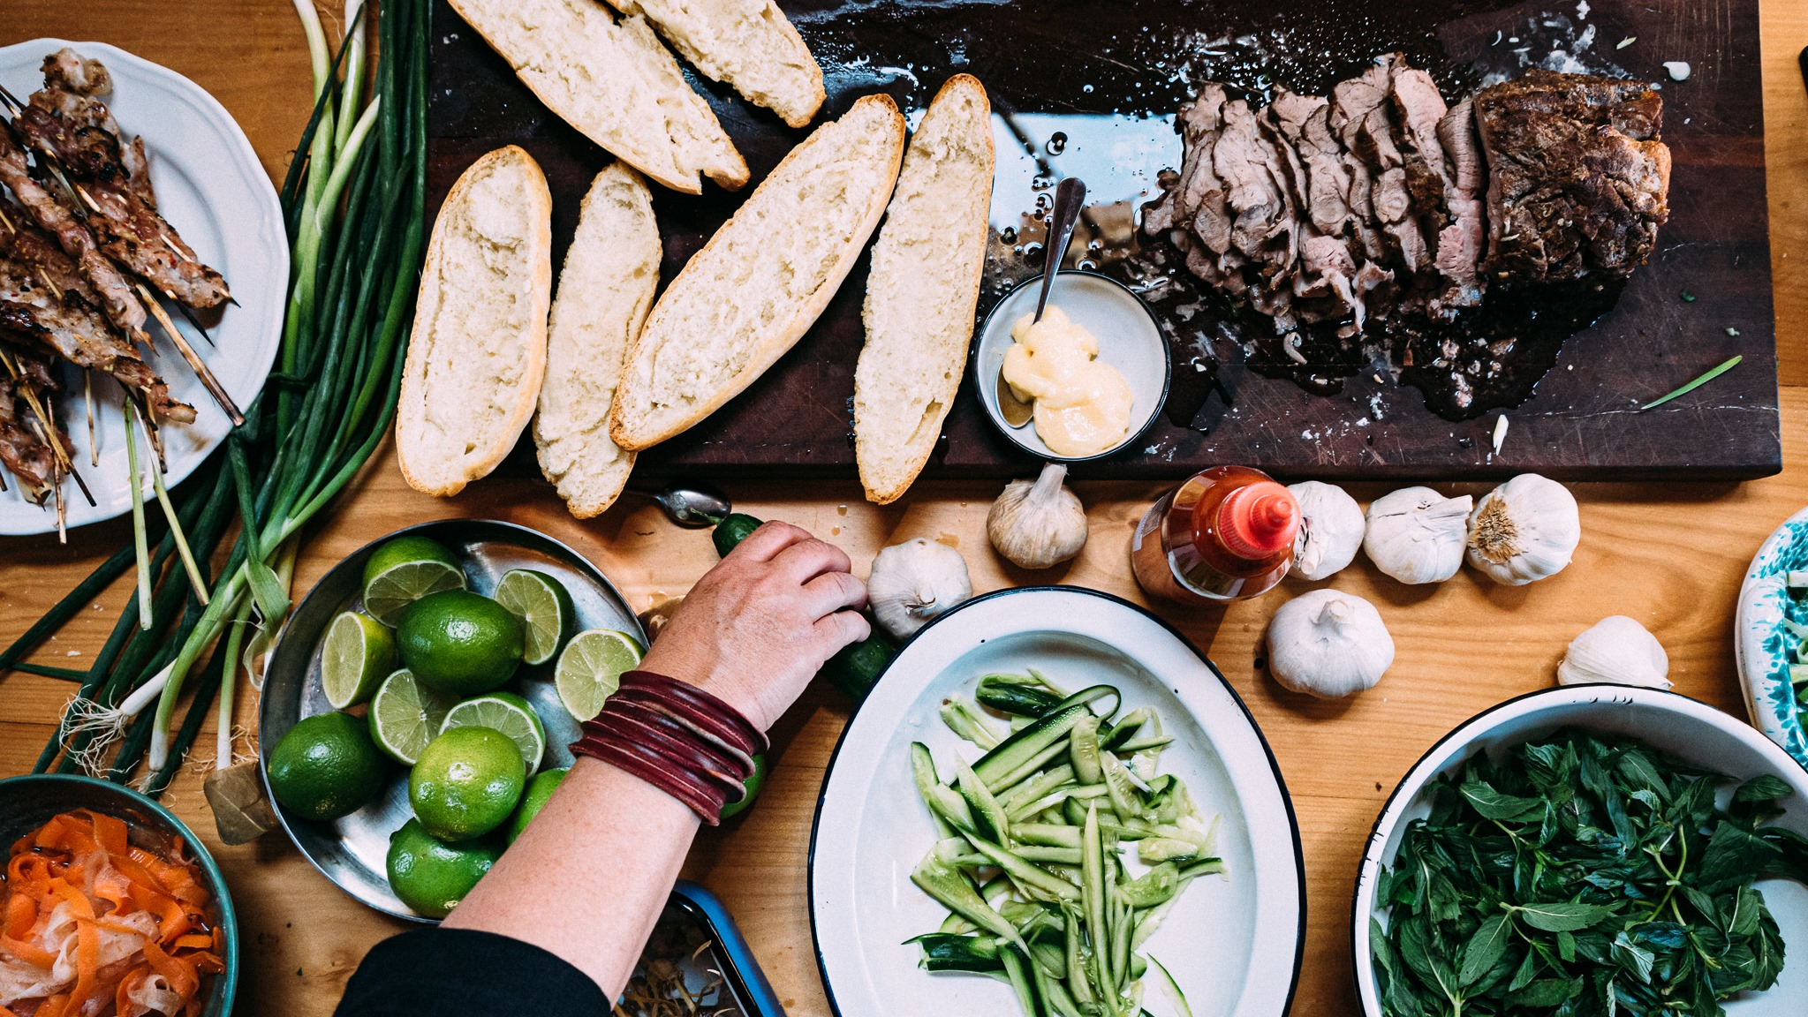
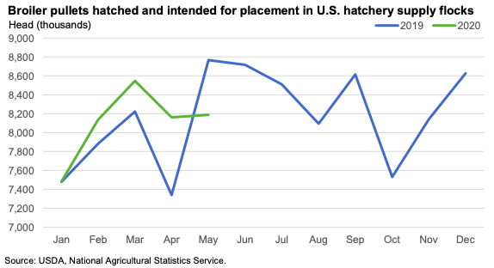
- Production forecasts have been increased as far as 2021 but May data suggests producers intend to slow the rate of expansion

Slide 15
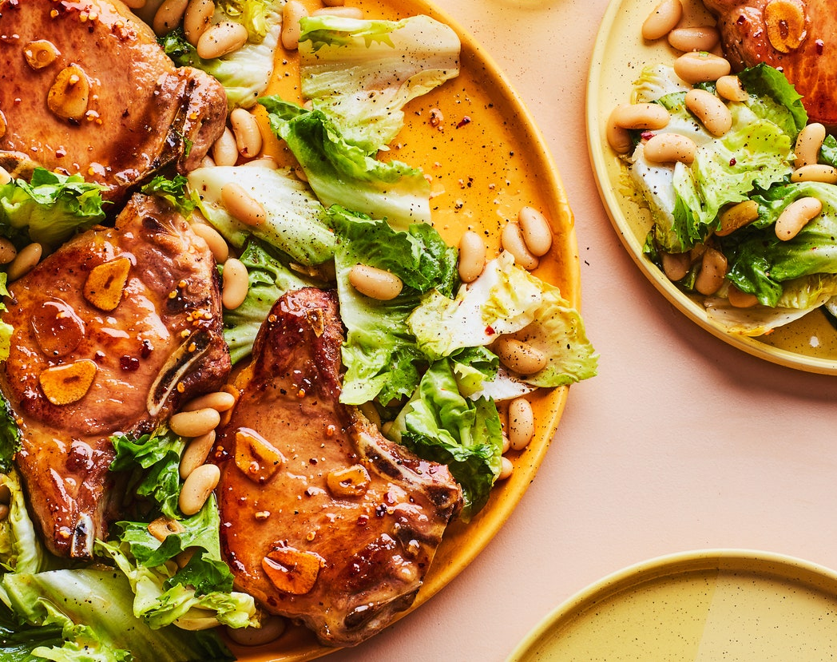
Prices continue to be historically low—this is the lowest price on record since 2009 and is 20% lower than 2019
Production expectations continue to be abundant for the remainder of the year, keeping wholesale prices depressed

Slide 16
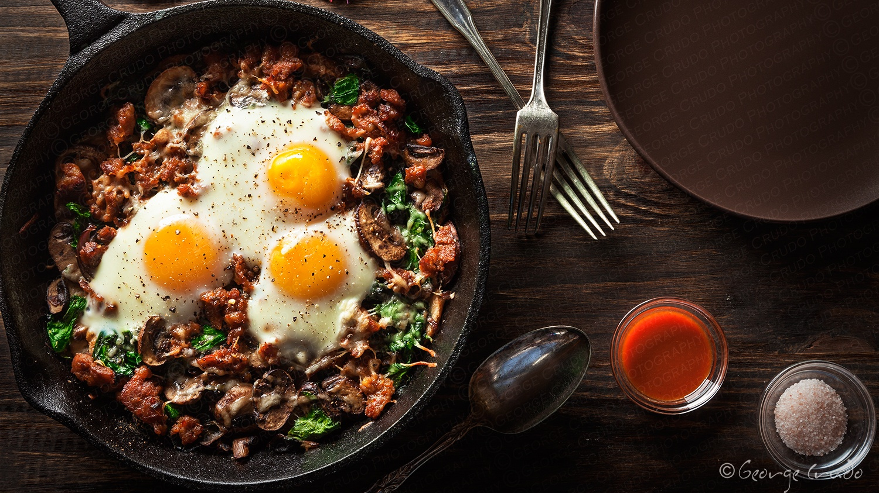
Egg

Slide 17
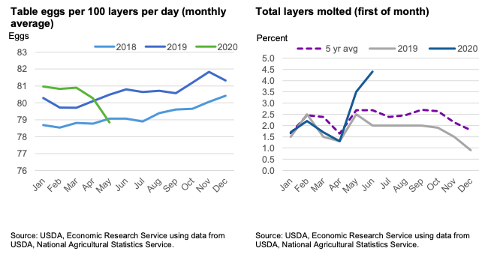
- Lay rates have drastically decreased in response to an increased share of molted birds

Slide 18

- Currently, the share of molted birds is high so that farmers can meet any sudden demand increase - But share of molted birds is projected to decrease over time, causing lay rates to recover

Slide 19

Wholesale prices have begun gradually increasing since their drastic low point in June

Slide 20
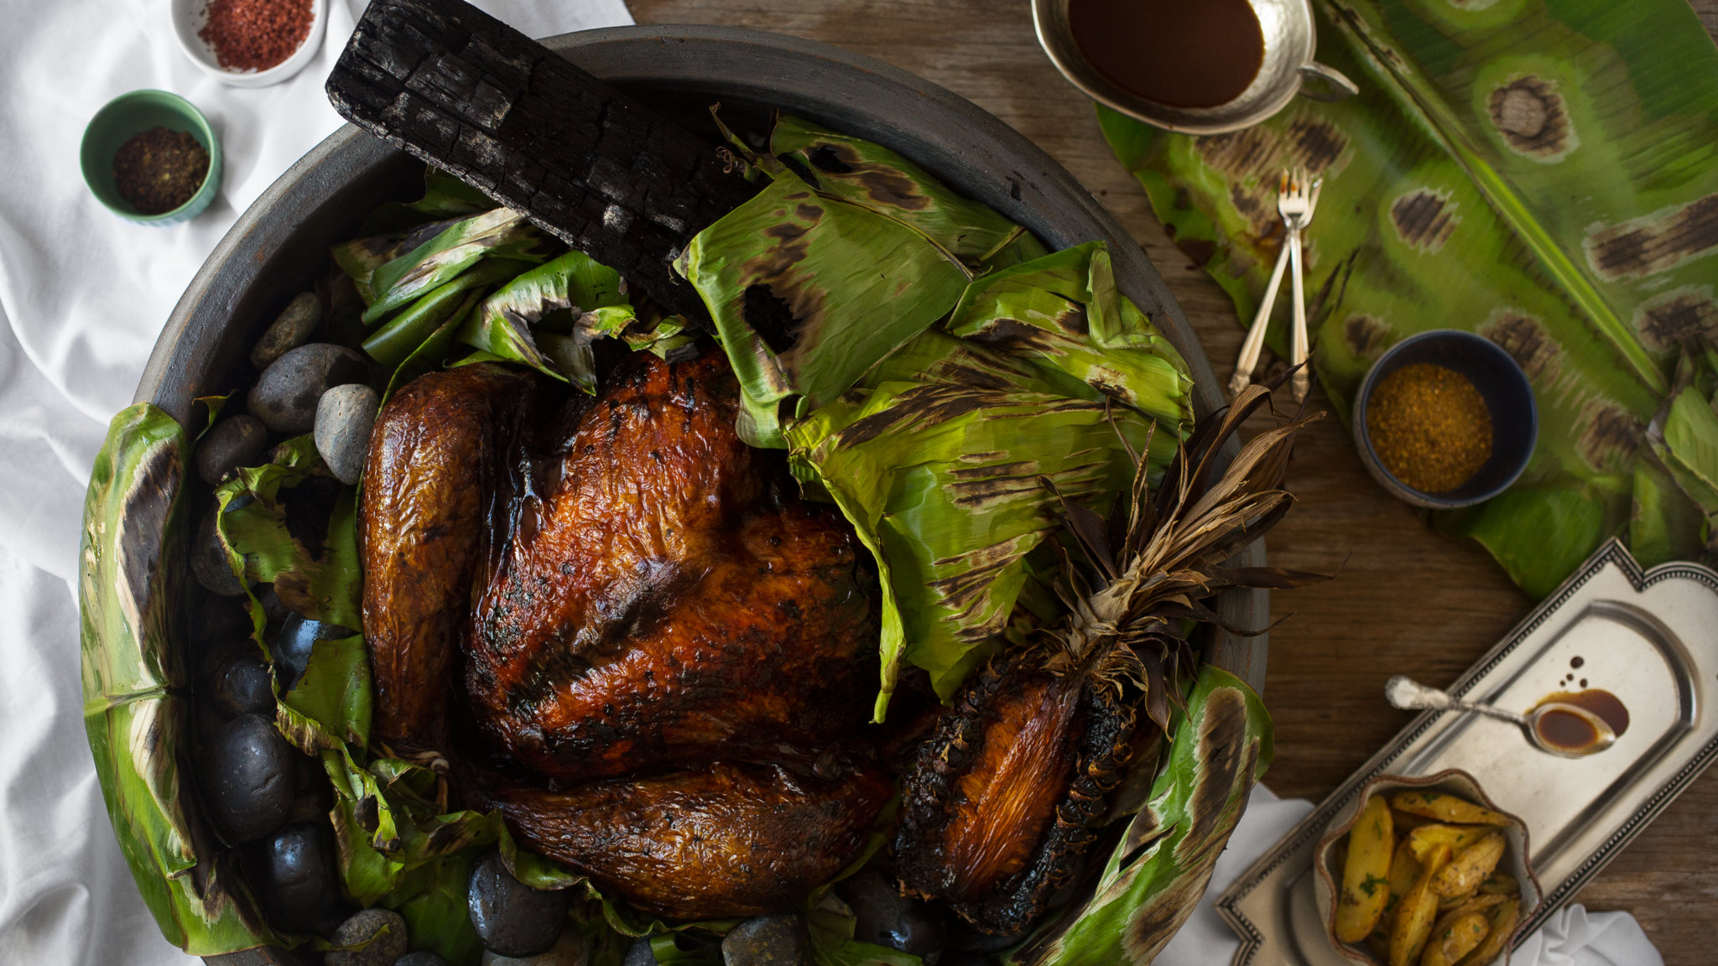
Turkey

Slide 21
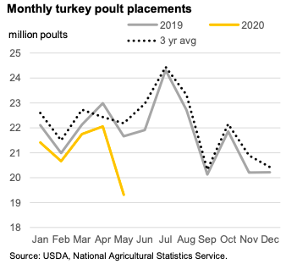
- This is a YOY decrease of 10.8 percent and the lowest number of poults placed in a month since September 2015.

Slide 22

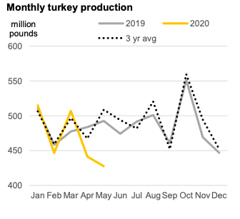
- Based on lower-than-expected placements, the third-quarter production projections have been lowered

Slide 23

With lower production, the third-quarter forecast prices have been revised up

Slide 24
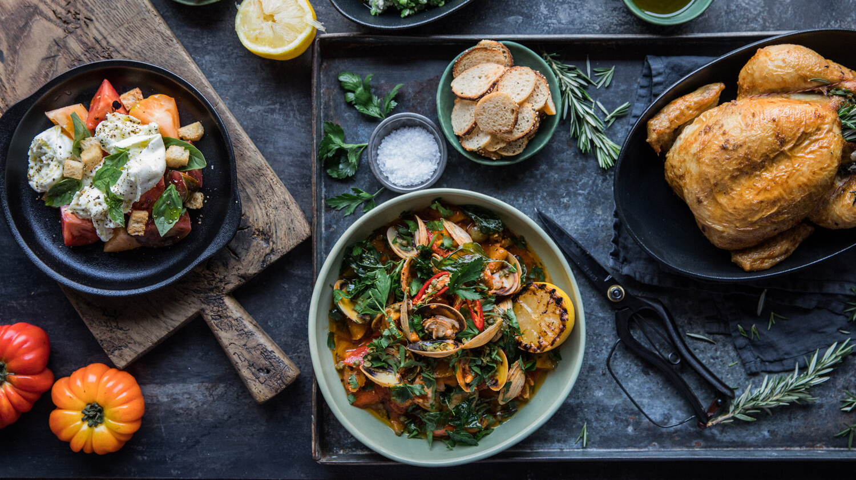
Our Recommendations

Slide 25
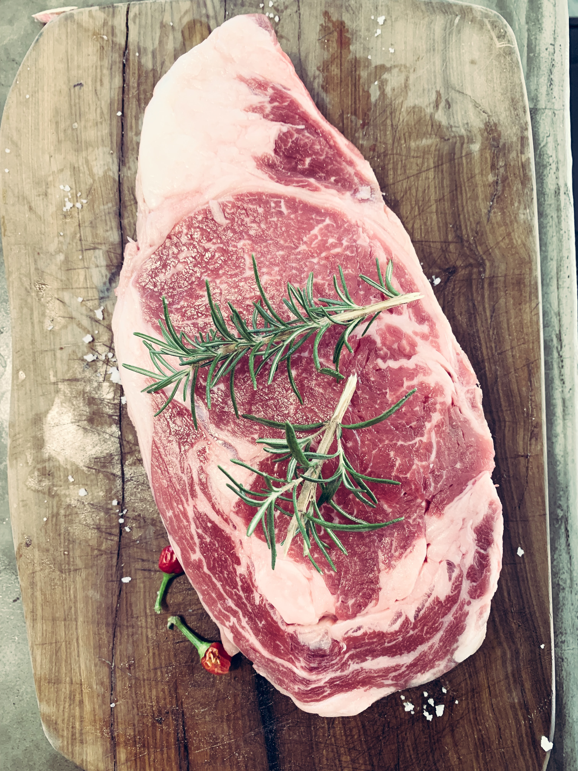
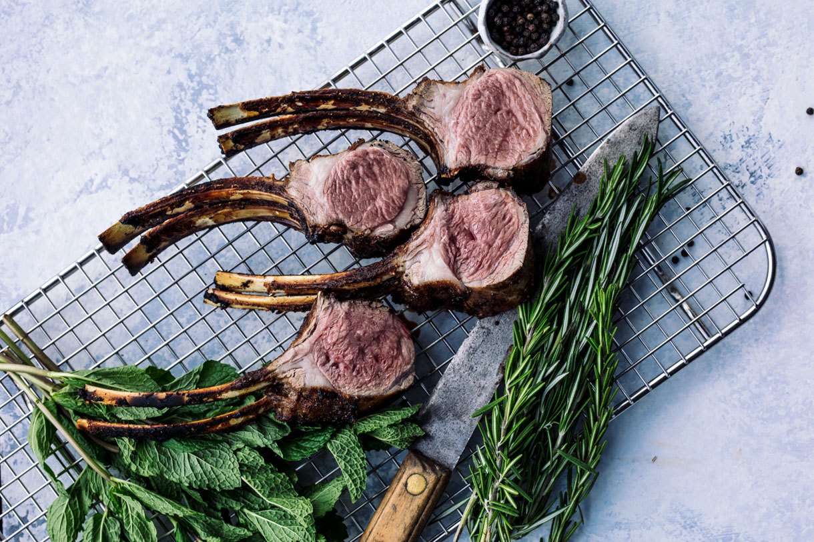
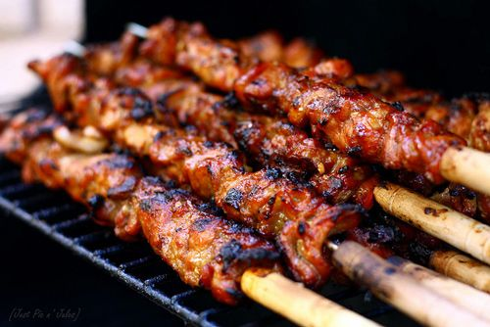
Beef/Cattle
Production is at a high in the next few months. This results in lower prices so now is the time to buy.
Pork
USDA is projecting third quarter prices to be 24% less than in 2019. We could save big here.
Chicken
Wholesale prices are the lowest in 10 years. With a focus on shifting to more chicken products, this is a homerun.

Slide 26

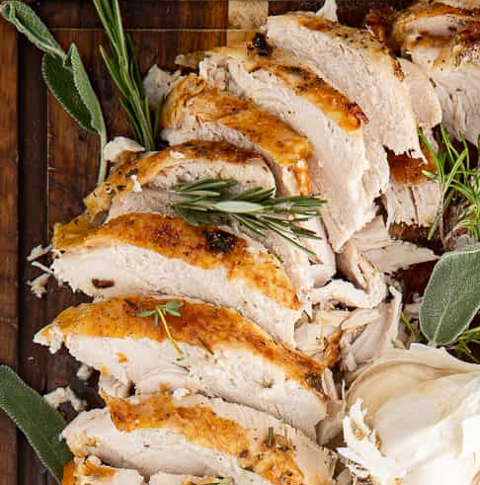
Eggs
With lay rates recovering, farmers are ready to meet any market demand. Purchase sooner rather than later as prices are increasing.
Turkey
With a major decrease in production, turkey prices have been projected to be higher than normal in the next quarter and beyond.

Slide 27

Thank you!
Source: LDP Outlook

